Slide 1
Predicting Solar Installation Adoption Rates
James Nelson
MSDS692 Data Science Practicum I
Professor Gannous, Aiman
Regis University

Slide 2
Project Overview
Issue: There are currently no Colorado state tax incentives.
What we do have: Solar renewable energy credits, and federal solar tax credits (26% of the total cost).
Solution: Increase state tax incentives.
Increase state tax incentives by $2,000 to increase adoption rates.
With incentives lower the avg system payback (from collected address sample size).
The plan: Mine, clean, explore, model data to predict future adoption rates.
Gather random housing address sample data to engineer the adoption rate incentive feature.
Gather CO total energy consumption, production, price expenditure, CO2 emissions for main dataset.

Slide 3
Data Mining/Cleansing
U.S. Energy Information Administration
The Demography of Household Data in Colorado Counties
Zip code, Random Address, and Solar data for Addresses Data
Per Capita Personal Income for Each County in Colorado Data
Colorado Annual GDP in Current Dollars Data
Annual kWh per Random Address Data
Average Household Savings Based on Income Data
Annual Installed Capacity MW Dc Data (Wood Mackenzie Power & Renewable Energy)
NREL's Assumed Levelized Cost of Energy Data
Notes:
There were many other datasets I had mined from many other sources, but these are the ones I actually mined, cleansed and explored.

Slide 4
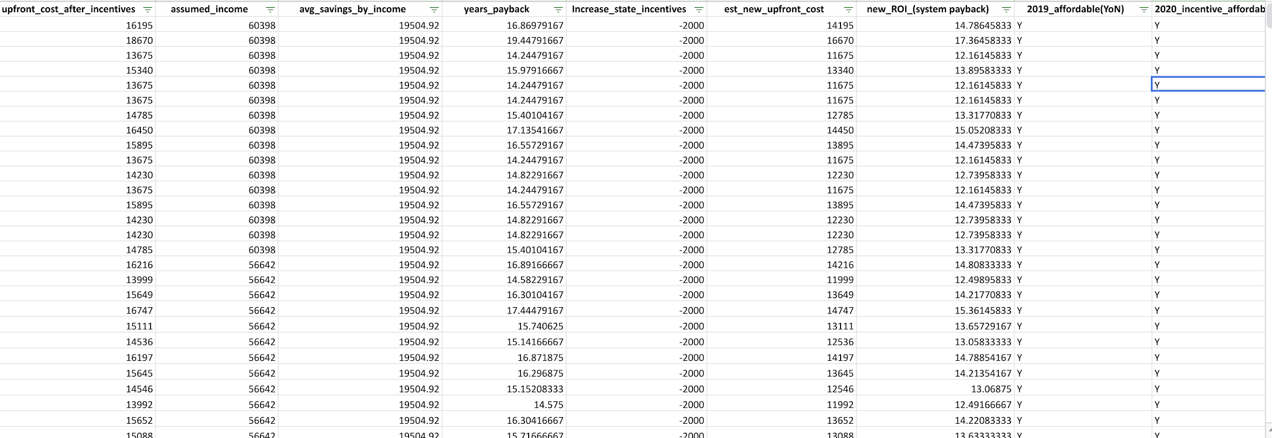
Feature Engineering (Solar Address dataset)
499 samples, float64/int64 Initial avg of system payback: 15 years
Avg after incentives system payback: 13 years
Households installed in 2019: 406
In 2020 (after incentives): 68 out of the 93 that remained (a 73% increase)
Notes:
The increase will be calculated into Wood Mackenzie Annual installation MWdc data as an annual assumed percentage increase to engineer features in that dataset.

Slide 5
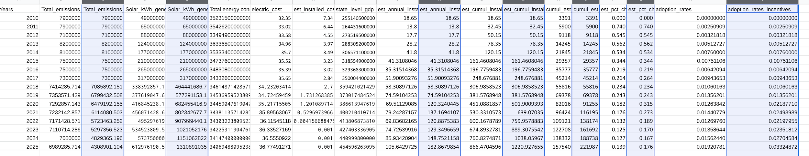
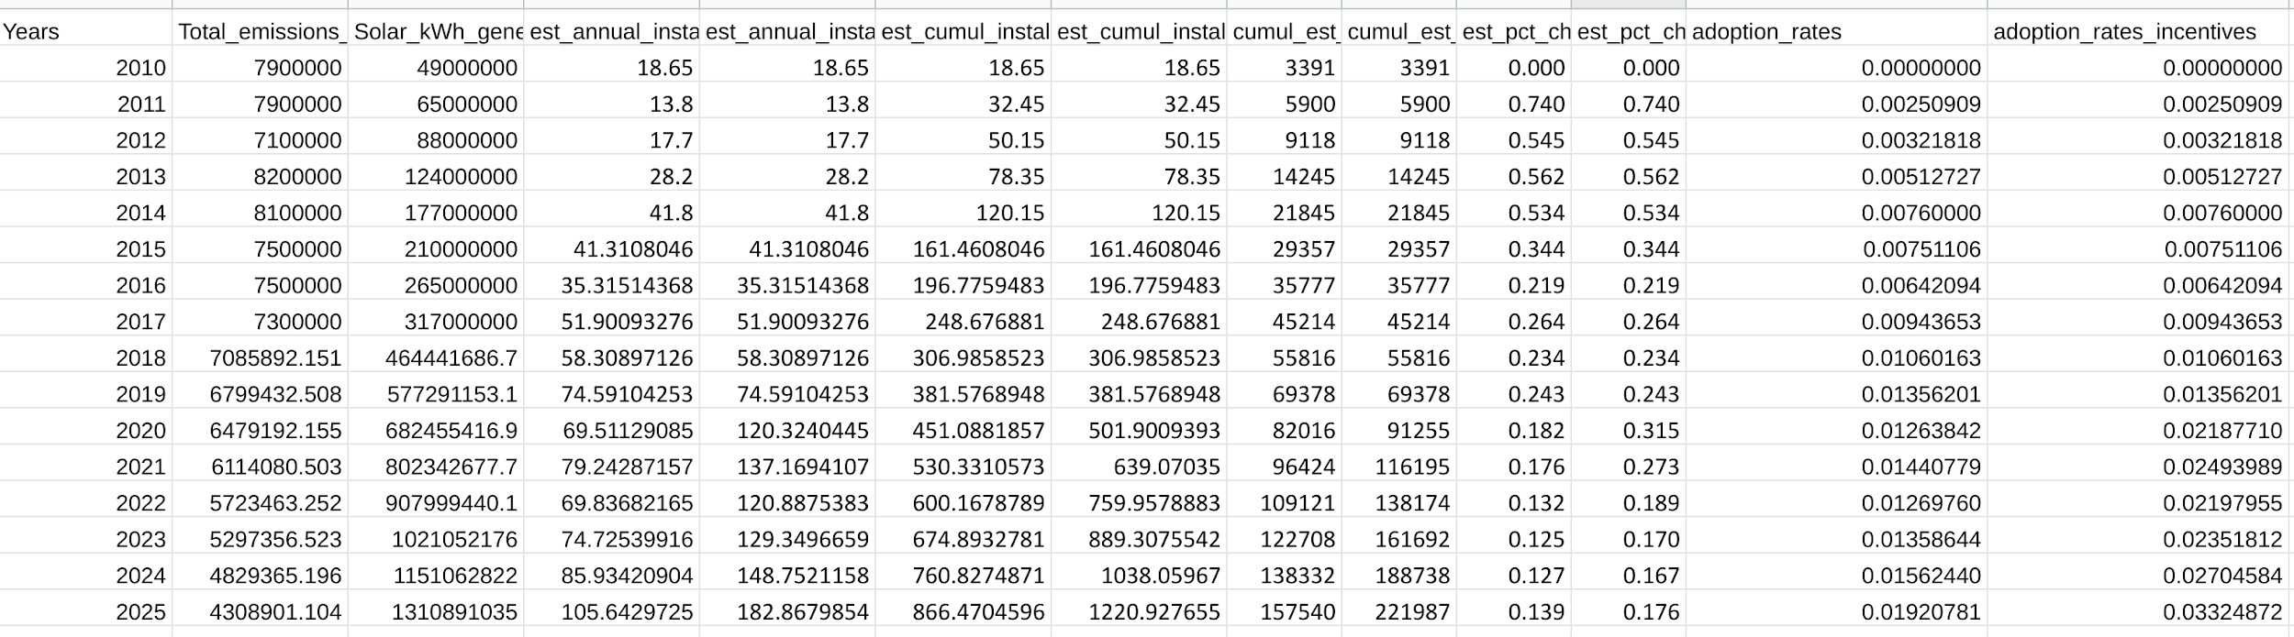
Imputations/Feature Engineering (Main Dataset)
Notes:
Annual Installed Capacity MWdc 2010-2025e
Used sheets forecast.linear to impute values for emissions, solar generation, energy consumption, electric cost, est install $/W, and state level GDP
Engineered cumulative est install cap, est roof install, est % chng, adoption rates
Engineered est annual install capacity (w/incentives using the 73% pct increase) from the Installation original installation capacity feature
With the new est annual install capacity feature I engineered the twin sister features for all of them except total energy, electric cost, est installed $/W, and State level GDP.

Slide 6
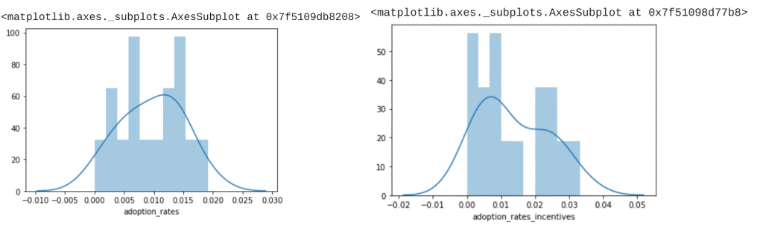
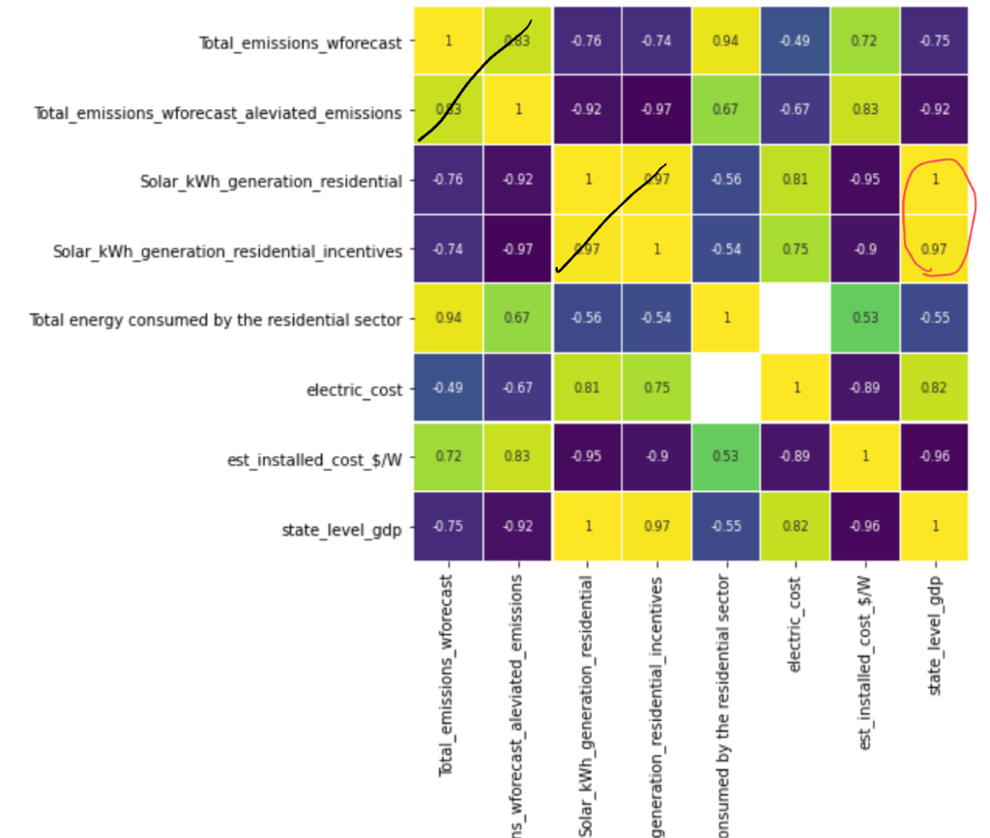
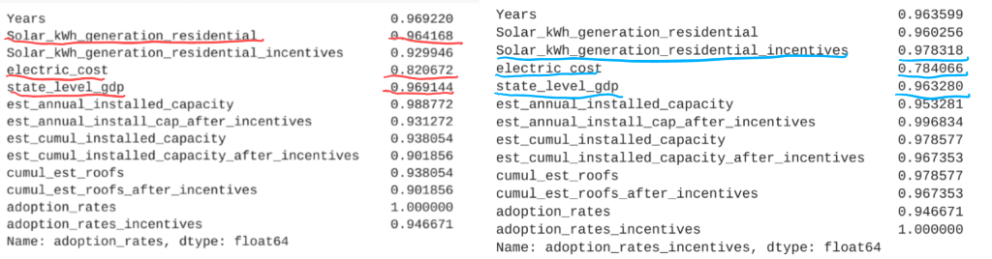
Exploring the Dataset and Feature Selection

Slide 7
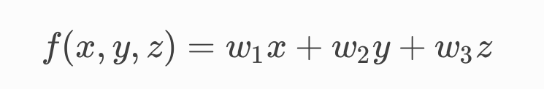
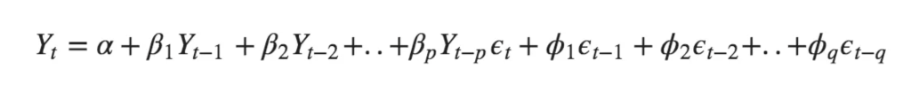
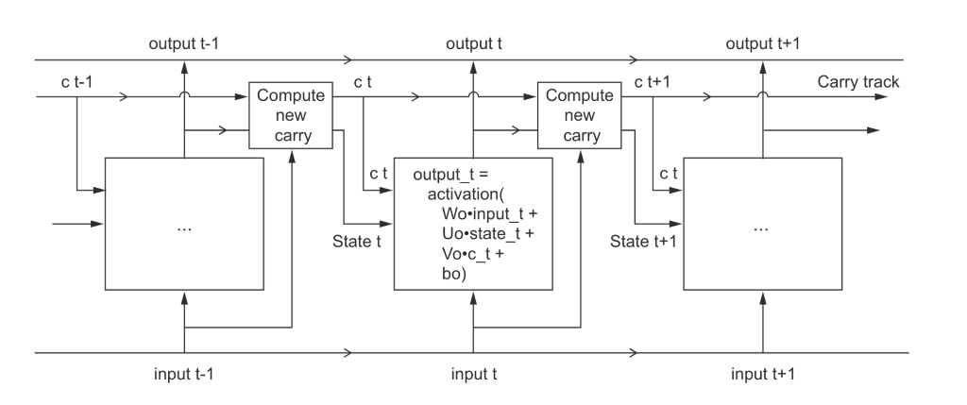
Machine Learning
Multivariate Linear Regression
AutoRegressive Integrated Moving Average
Long-Short Term Memory Reccurent Neural Network
Notes:
Linear regression: After the calculations of the features with the updated weights in a matrix, the bias calculations are added on.

Slide 8
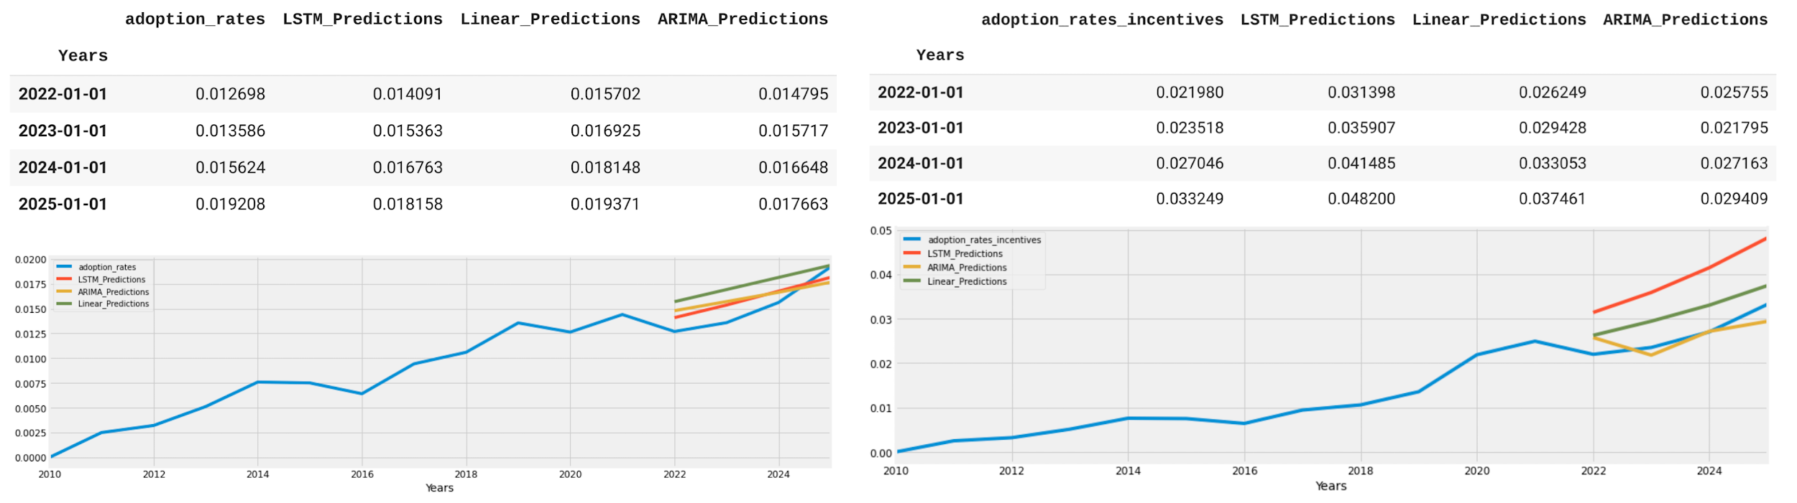
Machine Learning Results
Best Model: LSTM (before incentives)
Best Overall Model: ARIMA
MSE Error: 1.8736872707858614e-06
RMSE Error: 0.0013688269688992328
Mean: 0.009634323404375
Mean absolute error: 0.0013395018365797108
R^2 Value: 0.7012050606554092
MSE Error: 3.092111739895624e-06
RMSE Error: 0.0017584401439615805
Mean: 0.009634323404375
Mean absolute error: 0.0016988246861138093
R^2 Value: 0.5069041914442292
MSE Error: 7.995021109432833e-06
RMSE Error: 0.0028275468359397395
Mean: 0.013662246083125001
Mean absolute error: 0.002363815965094858
R^2 Value: 0.5744979957219085

Slide 9
Conclusion/Proposal
More data
Underfitted models.
solution for that is to get monthly installation capacity data of MWdc and rooftop installations.
Larger sample size for the adoption rates feature.
Conduct a voluntary survey asking Colorado population simple questions
“Are you interested in installing solar panels on top of your house if it meant you could save money on your electric bill?” (sample potential)
“Can you afford to install one right now?.” (gives us yes and nos before incentives)
“If there were $2000 state tax incentives in Colorado to install solar panels on your house, would you consider doing so?” (gives yes and nos after the mention of incentives)

